Slide 1
Fish Study
Member:
Võ Hoài Em
Vũ Xuân Trí
Nguyễn Bách Toàn

Slide 2



Screen
Home
Study
Fish information

Slide 3
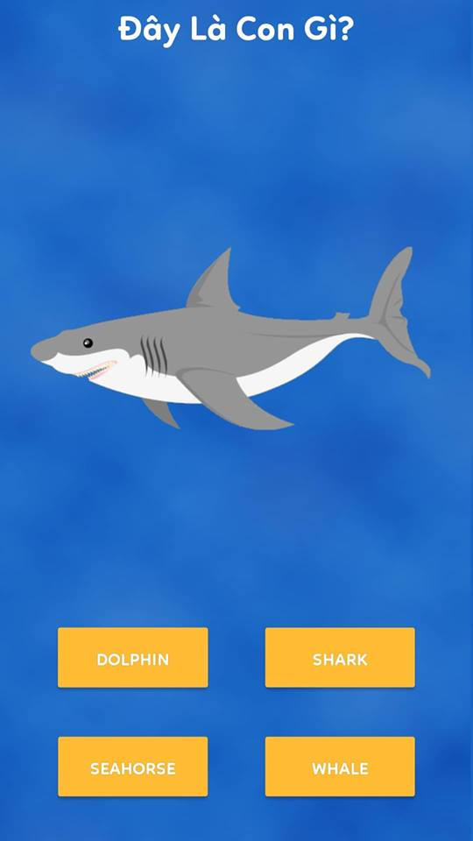


Screen

Slide 4
Features
API: [IPV4 LAN WIFI IP]:[PORT]
Server: using Spring Boot
Database: MySQL
Image-loading: Glide

Slide 5
Config maven turorial
Note
Maven 3.3+ requires JDK 1.7+
Maven 3.2 requires JDK 1.6+
Maven 3.0/3.1 requires JDK 1.5+

Slide 6
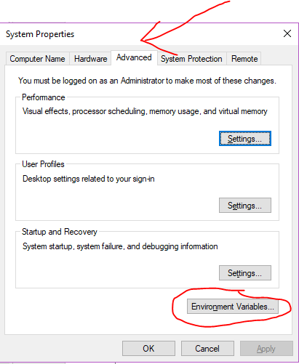
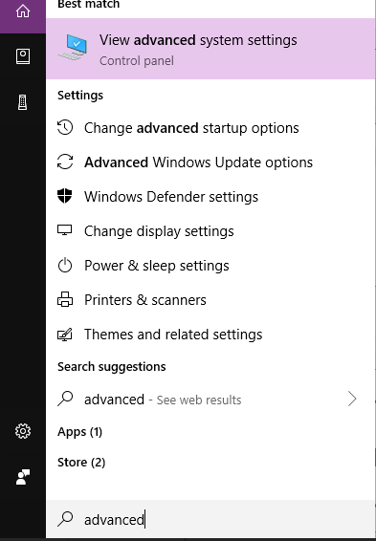
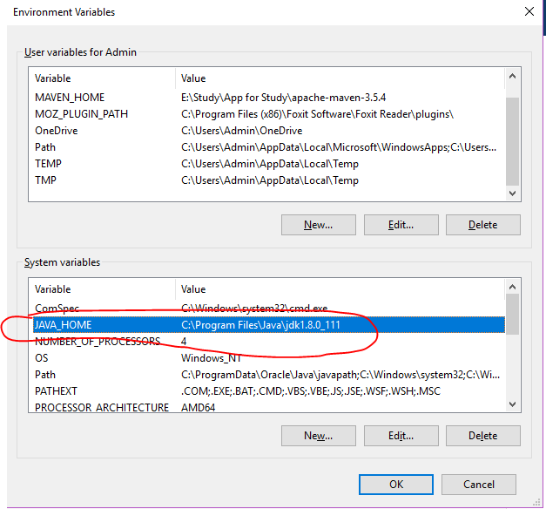
Make sure JDK is installed, and JAVA_HOME environment variable is configured.

Slide 7
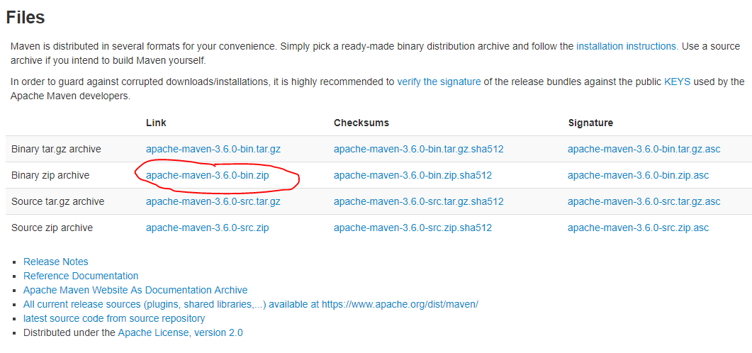
Guide to config maven
To install Apache Maven on Windows, you just need to download the Maven’s zip file, unzip it to a folder, and configure the Windows environment variables.
Link: http://maven.apache.org/download.cgi

Slide 8
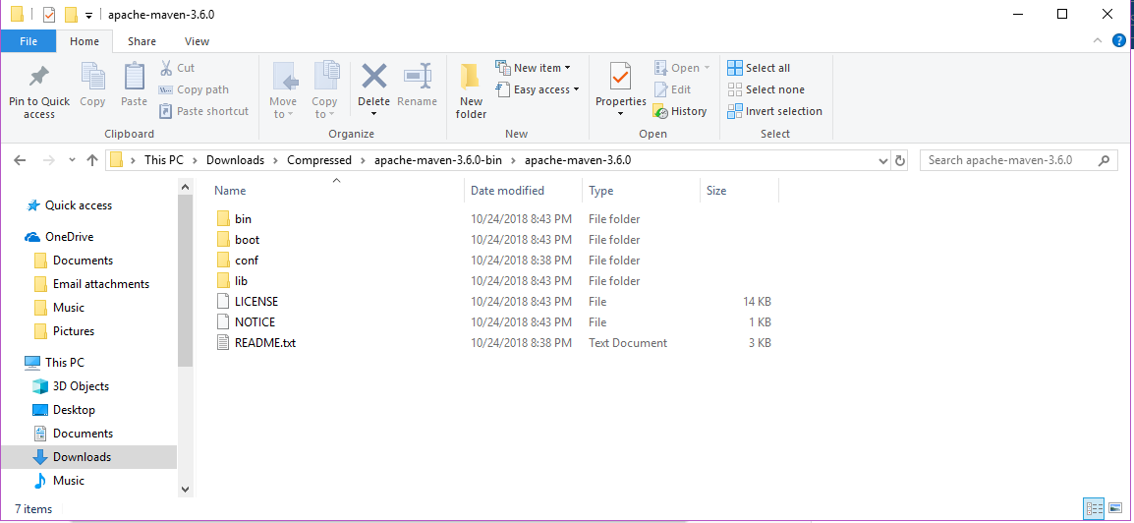
Unzip it to a folder. In this article, we are using c:\opt\apache-maven-3.6.0
Note That’s all, just download and unzip, installation is NOT required.

Slide 9
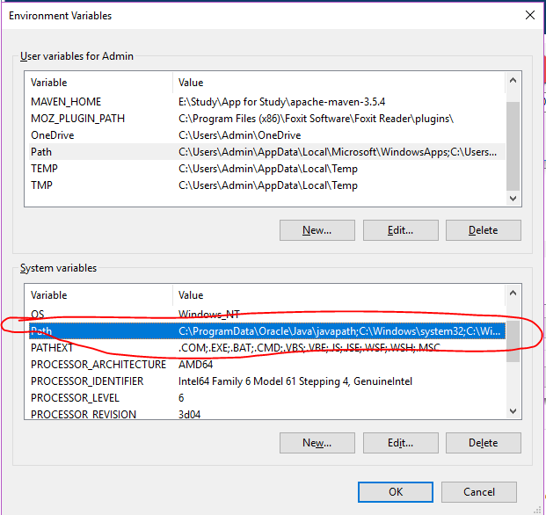
3. Add system variable
Add a system variables, and point it to the Maven folder.
In “Environment variables” dialog, System variables, double click into Path

Slide 10
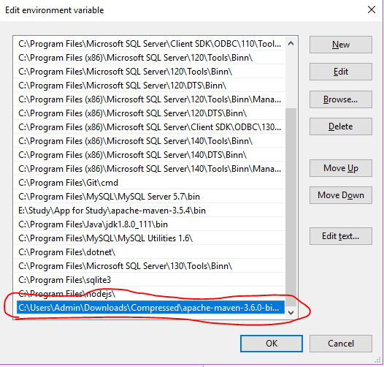
Click new and add path that link to your maven folder (bin)

Slide 11
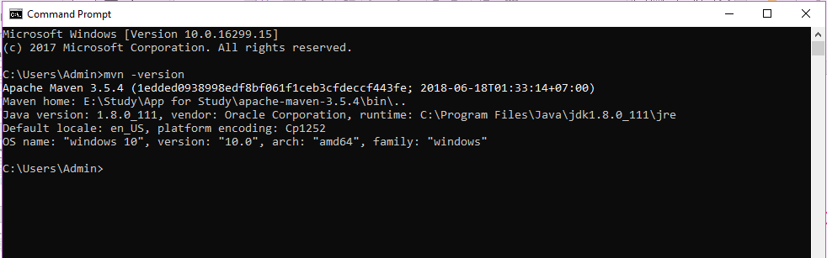
Verification
Done, start a new command prompt, type mvn –version :

Slide 12
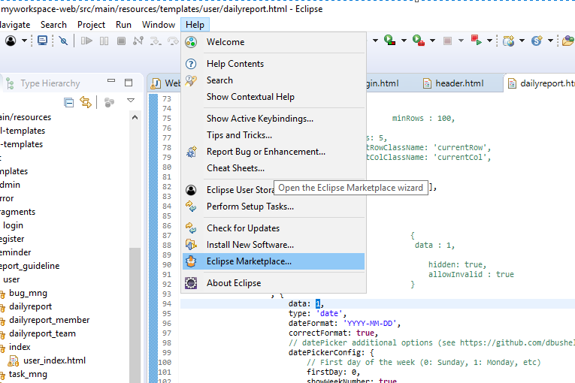
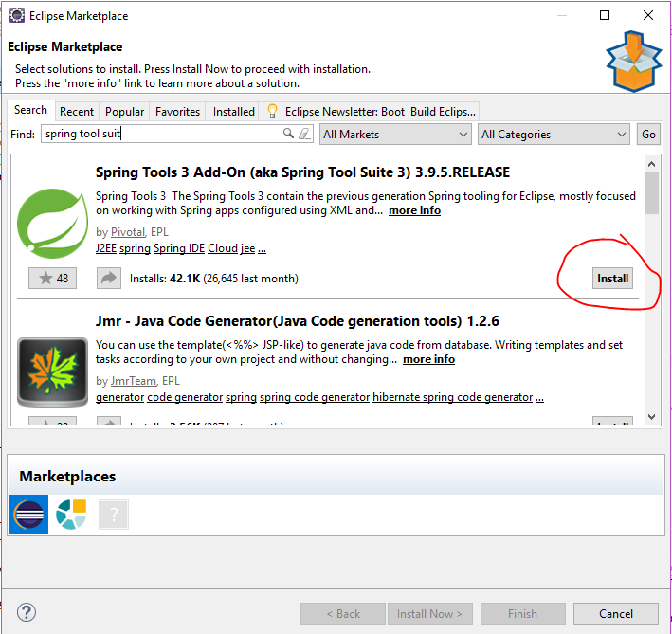
Download Spring tool suit (For Esclipse)
Download SPS to run project as Spring boot app

